Slide 1
Office DEVCamp – Los Angeles
Module 4: Hooking into Office 365 APIs
Registration for Los Angeles June 16 2015
http://aka.ms/O365campLA

Slide 2
Course Agenda
Office Camp
Module 1: Introduction to the Day
Module 2: Setting up the Environments
Module 3: Hooking into Apps for SharePoint
Module 4: Hooking into Office 365 APIs
Module 5: Hooking into Apps for Office
Module 6: Hooking into SharePoint APIs with Android

Slide 3
Hook into Office 365 APIs
Ivan Sanders
SharePoint MVP/MCT
ivan@dimension-si.com
@iasanders

Slide 4

Agenda
Introduction
Connecting Calendar, Mail, and Contacts
Connecting OneDrive for Business
Connecting SharePoint Sites

Slide 5
Introduction

Slide 6
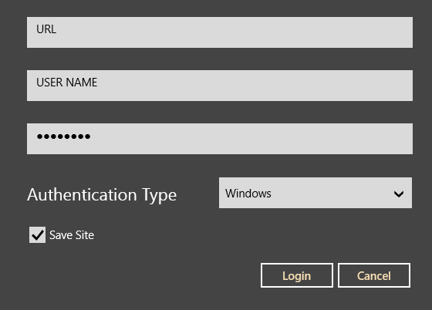
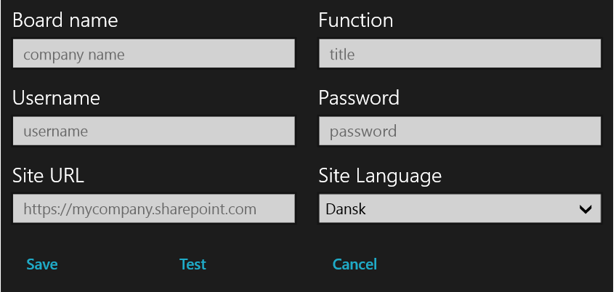
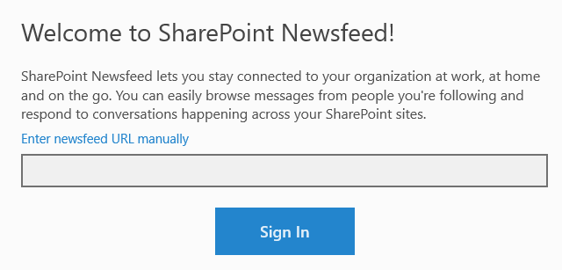
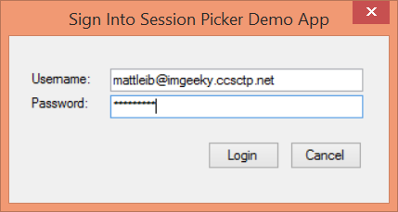
Office 365 Device Apps
Notes:
Prior to the release of the Office 365 APIs, device apps had to prompt users for credentials for the service, and in some cases the location of the resources. Storing credentials is very risky, and a worst practice.

Slide 7
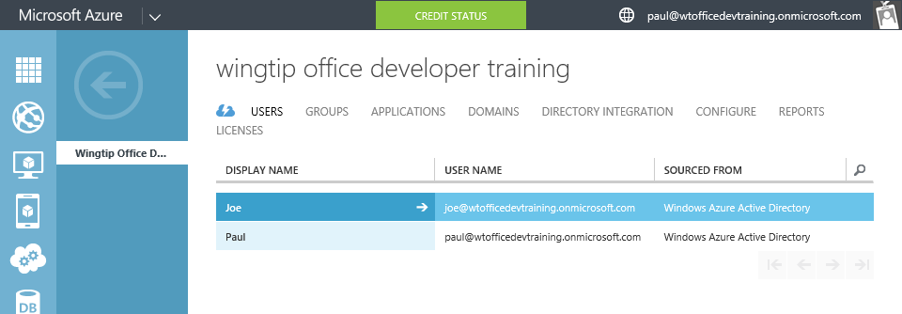
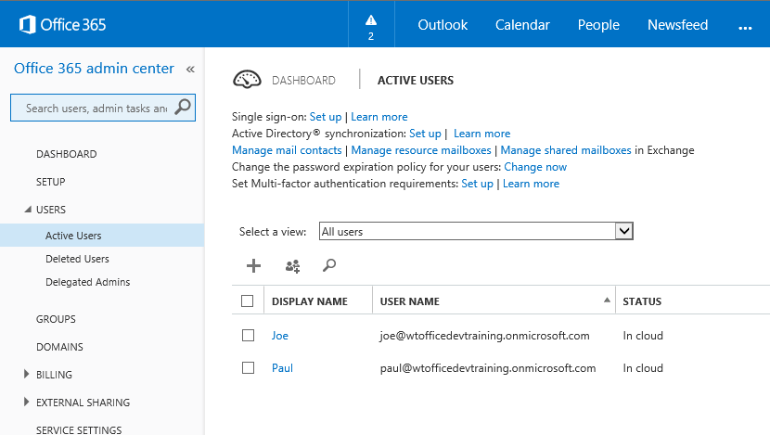
Azure Active Directory (Azure AD)
Included in Office 365 Subscription
Users & Groups managed in Office 365 Portal
Changes persisted in Azure AD
Notes:
Although an Azure AD is included with Office 365, accessing it via the Azure Management Portal requires a “sign-up.” However, there are no charges from Azure for using AD. (Charges will occur if other services are used.)

Slide 8
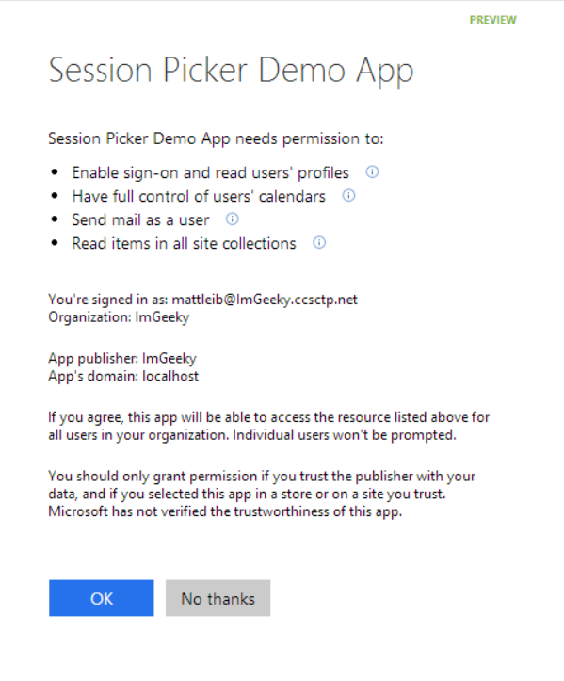
Azure AD OAuth in Office 365
Single auth flow for Office 365
Azure AD Graph, Exchange, SharePoint
Device apps and web sites
Admin and end-user consent
Secure protocol
OAuth 2.0
No capturing user credentials
Fine-grained access scopes
Supports MFA and federated user sign-in
Long-term access through refresh tokens
Notes:
With the Office 365 APIs, which leverage the Azure AD Oauth service, device apps no longer need to store user credentials. Azure AD has implemented a “Common Consent” dialog, providing a consistent interface for permission grants. Typically, OAuth is used to access a single resource. Common Consent is unique in that it can provide a token to Exchange Mail/Calendar/Contacts as well as SharePoint lists and files in OneDrive .

Slide 9
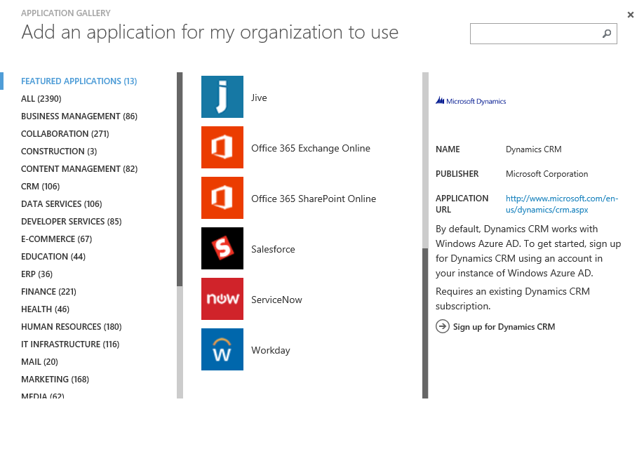
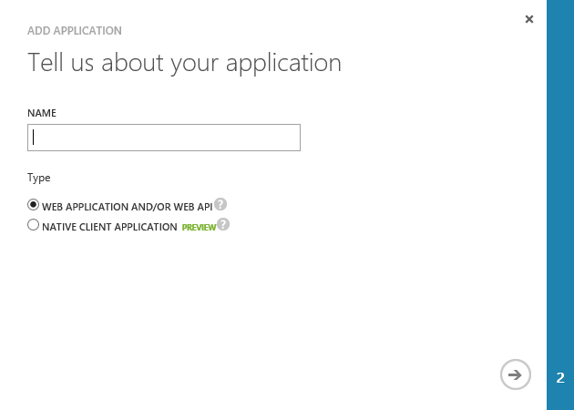
Application Registration
Application Types
Custom developed
Third-party, published in the gallery
Office 365 SharePoint, Exchange
Dynamics CRM
Thousands of others
Custom Applications
Web Application and/or WebAPI
Native Client

Slide 10
O365 Discovery Service
Returns a collection of endpoints specific to current user
Intended as the starting point for application
1. Sign-In
2. Get authorized
3. Discover endpoints for resource
4. Get Token
5. Access resource
API Libraries simplify necessary code

Slide 11
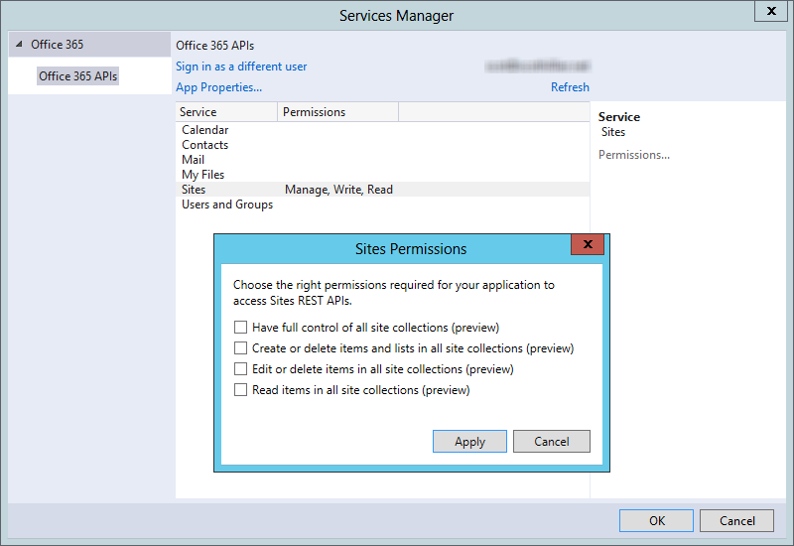
Connected Services in Visual Studio

Slide 12
Connecting Calendar, Mail, and Contacts

Slide 13
Office 365 APIs for Calendar, Mail and Contacts
Office 365 APIs
Mail Message API
Calendar Events API
Contacts API
Office 365 APIs accessible through REST
https://outlook.office365.com/api/v1.0/Me/Messages
https://outlook.office365.com/api/v1.0/Me/Events
https://outlook.office365.com/api/v1.0/Me/Contacts
Office 365 APIs accessible through OutlookServicesClient
A library which abstracts away sending and receiving REST request

Slide 14
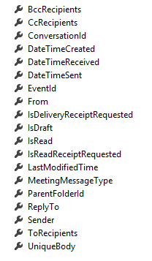
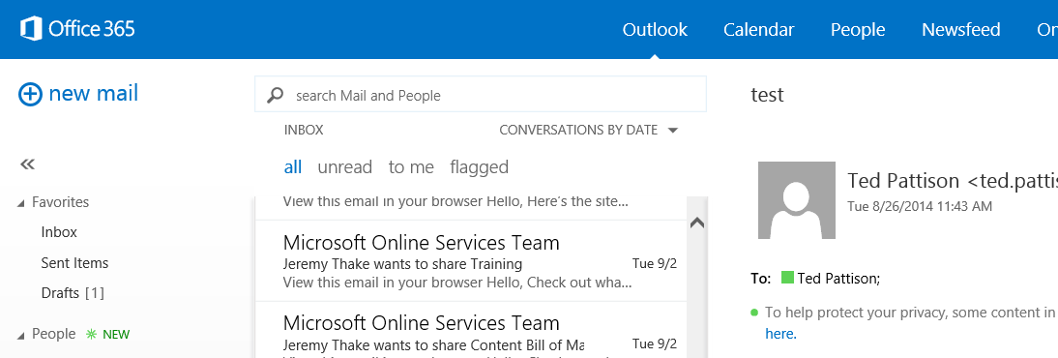
Mail Messages
Message
Common API operations
Reading messages
Deleting messages
Sending messages
Working with attachments

Slide 15
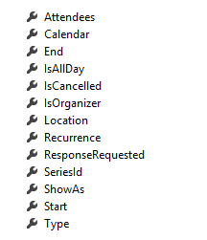
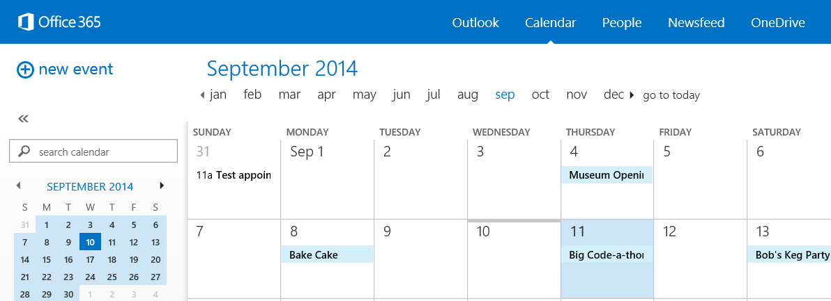
Calendar Events
Common API operations
Reading events for specific date range
Creating events
Deleting events
Editing events
Event

Slide 16
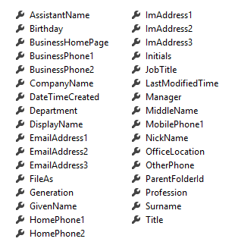
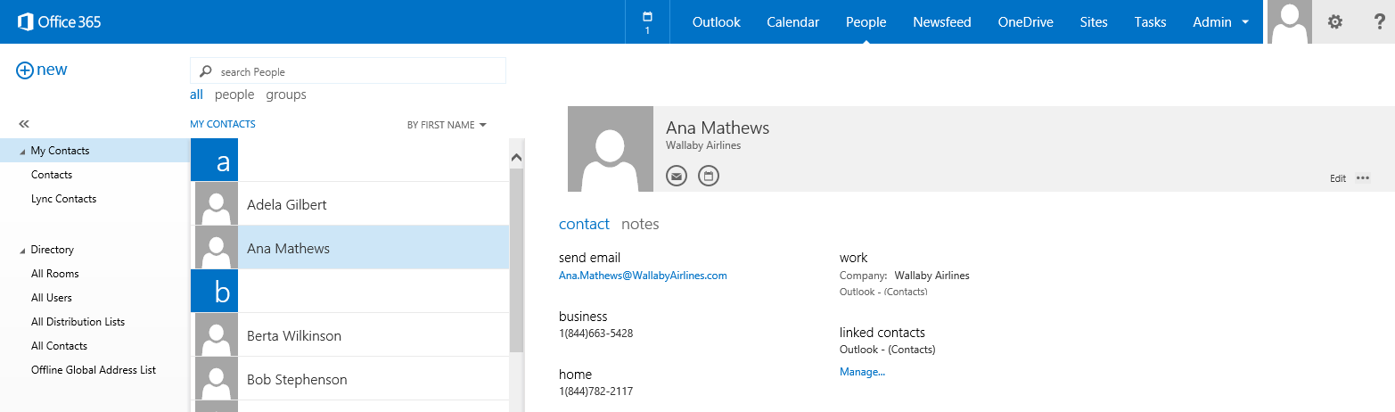
Contacts
Common API operations
Reading contacts
Searching for contacts
Creating contacts
Deleting contacts
Editing events
Contact

Slide 17
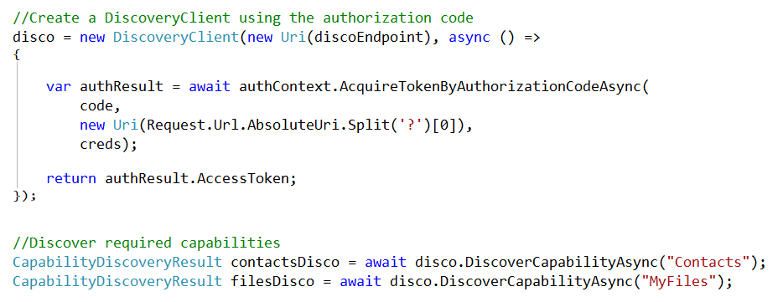
Coding the Discovery Service

Slide 18
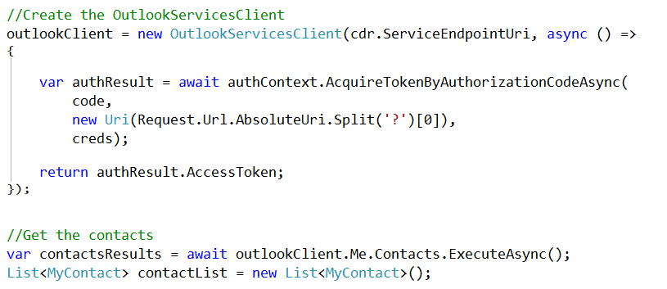
Retrieving Contacts

Slide 19
Single Sign-On, Multi-Tenant
Important scenario for apps
Open ID Connect Protocol
OWIN Middleware
Azure AD Authentication Library
GitHub Sample

Slide 20
Connecting OneDrive for Business

Slide 21
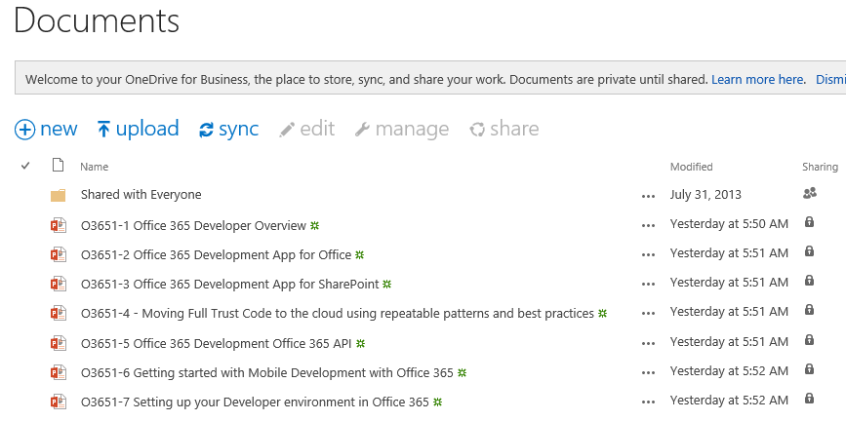
OneDrive for Business
A personal library for storing and organizing your work documents
Notes:
OneDrive for Business is a personal library intended for storing and organizing your work documents. As an integral part of Office 365 or SharePoint Server 2013, OneDrive for Business lets you work within the context of your organization, with features such as direct access to your organization’s address book.
Note
OneDrive for Business is different from OneDrive, which is intended for personal storage separate from your workplace.
OneDrive for Business is also different from your team site, which is intended for storing team or project-related documents.

Slide 22
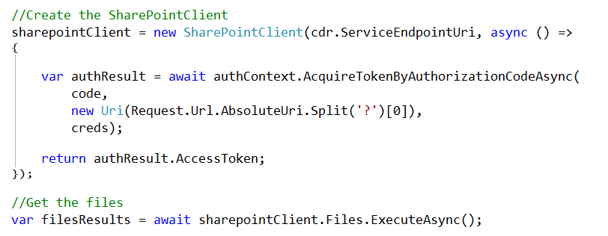
SharePointClient class
Discovery Service discovers “MyFiles” capability
Returns tenant and user-specific URL for user’s OneDrive for Business
SharePointClient.Files abstracts Files API
Notes:
The discovery service discovers the “MyFiles” capability, which will always try to access the OneDrive for Business library

Slide 23
Connecting SharePoint Sites

Slide 24
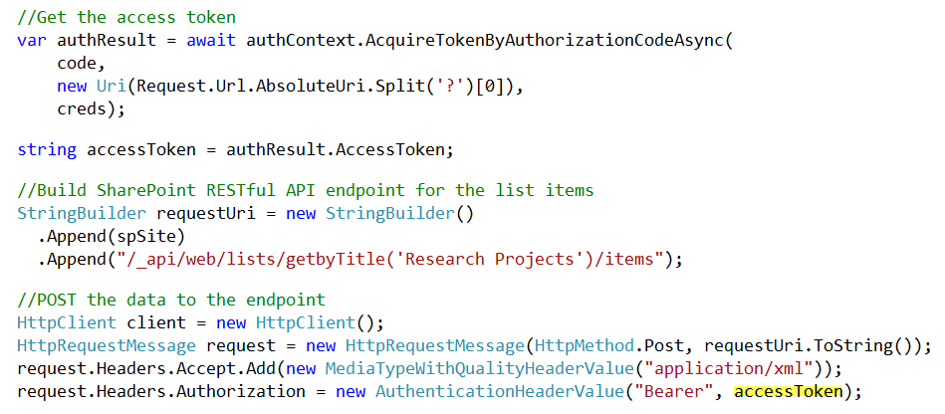
SharePoint Sites
Access the SharePoint REST API with the Access Token

Slide 25
Summary
Introduction
Connecting Calendar, Mail, and Contacts
Connecting OneDrive for Business
Connecting SharePoint Sites

Slide 26

© 2012 Microsoft Corporation. All rights reserved. Microsoft, Windows, and other product names are or may be registered trademarks and/or trademarks in the U.S. and/or other countries.
The information herein is for informational purposes only and represents the current view of Microsoft Corporation as of the date of this presentation. Because Microsoft must respond to changing market conditions, it should not be interpreted to be a commitment on the part of Microsoft, and Microsoft cannot guarantee the accuracy of any information provided after the date of this presentation. MICROSOFT MAKES NO WARRANTIES, EXPRESS, IMPLIED OR STATUTORY, AS TO THE INFORMATION IN THIS PRESENTATION.

